Slide 1
CS3391 Object Oriented Programming
Dr.D.Sivaganesan, Professor,
PSGiTech / CSE

Slide 2
Input / Output in JAVA
Java I/O (Input and Output) is used to process the input and
produce the output based on the input. Java uses the concept
of stream to make I/O operation fast.
The java.io package contains all the classes required for input
and output operations.
Scanner class
Using Scanner to read text data from keyboard
Use of Scanner is a more convenient and preferred approach for reading text data from keyboard.
Package : import java.util.Scanner;
DataInputStream
Reading text data from keyboard using DataInputStream
DataInputStream is a FilterInputStream that read primitive data from an underlying input stream in a machine-independent way.
Package : import java.io.*;

Slide 3
Scanner Class
Syntax :
Scanner obj=new Scanner(System.in);
Reading int value
int a=s.nextInt();
Reading float value
float b=s.nextFloat();
Reading double
double d=s.nextDouble();
Redaing a string
String str=s.next();
Reading a char
char c=s.next().charAt(0);

Slide 4
import java.util.*;
class input
{ public static void main(String args[])
{ int a; float b;double d; String str;char c;
Scanner s=new Scanner(System.in);
System.out.println("Enter Int value");
a=s.nextInt();
System.out.println("Int value :"+a);
System.out.println("Enter float value");
b=s.nextFloat();
System.out.println("Float value :"+b);
System.out.println("Enter double value");
d=s.nextDouble();
System.out.println("Double value :"+d);
System.out.println("Enter String");
str=s.next();
System.out.println("String :"+str);
System.out.println("Enter a char value");
c=s.next().charAt(0);
System.out.println("Char :"+c);
}}

Slide 5
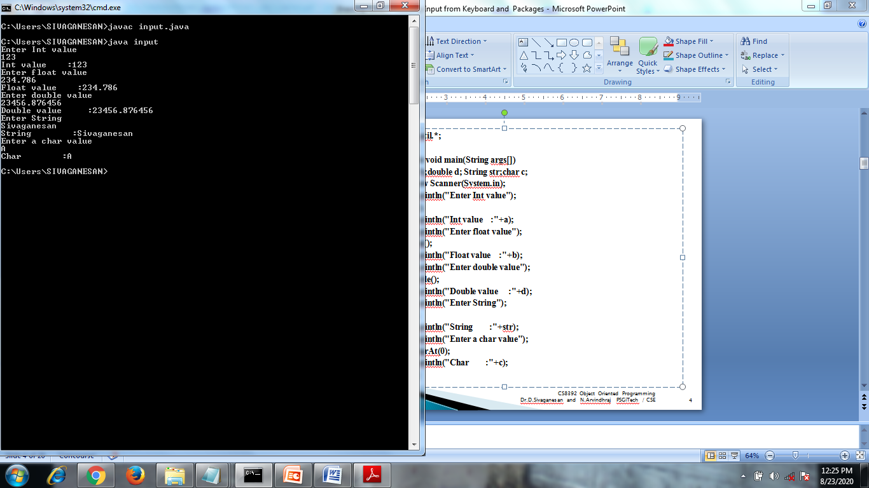

Slide 6
DataInputStream
Syntax :
DataInputStream obj=new DataInputStream(System.in);
Reading int value
int a=Integer.parseInt(s.readLine());
Redaing float value
float b=Float.parseFloat(s.readLine());
Redaing double value
double d=Double.parseDouble(s.readLine());
Reading string
String str=s.readLine();
Reading a char
char c=(char)s.read();

Slide 7
import java.io.*;
import java.io.IOException;
class datainput
{ public static void main(String args[]) throws IOException
{ int a;float b;double d;String str;char c;
DataInputStream s=new DataInputStream(System.in);
System.out.println("enter int value");
a=Integer.parseInt(s.readLine());
System.out.println(" int value :"+a);
System.out.println("enter float value");
b=Float.parseFloat(s.readLine());
System.out.println("enter float value :"+b);
System.out.println("enter double value");
d=Double.parseDouble(s.readLine());
System.out.println("double value :"+d);
System.out.println("enter string");
str=s.readLine();
System.out.println("string :"+str);
System.out.println("enter char");
c=(char)s.read();
System.out.println("char :"+c);
}}

Slide 8
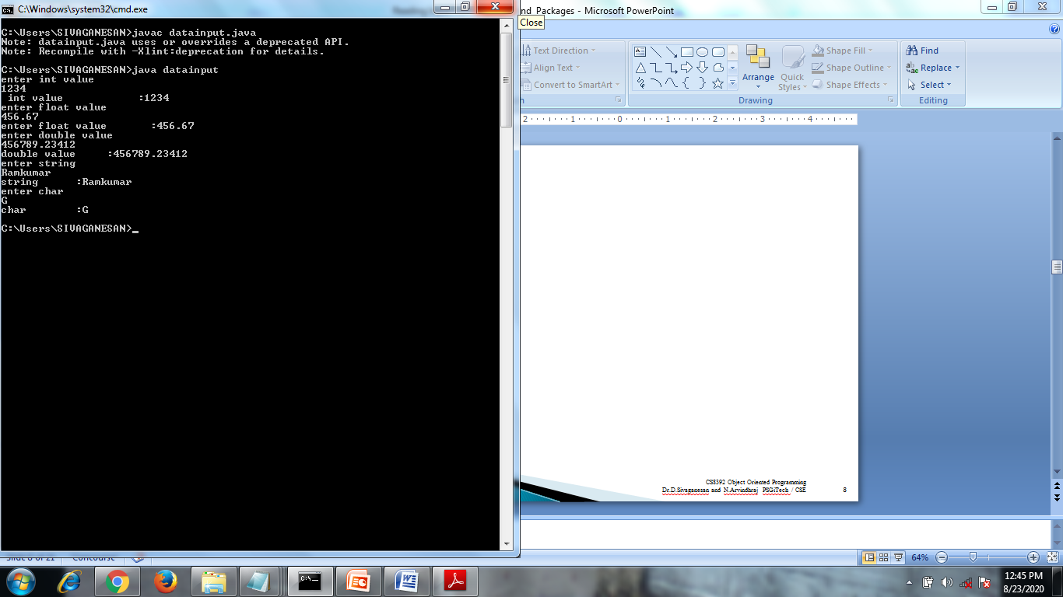

Slide 9
User Defined Package
To create a package include a package command as the first statement in a Java
source file. Any classes declared within that file will belong to the specified package.
The package statement defines a name space in which classes are stored.
If package statement is omitted, the class names are put into the default package,
which has no name.
Syntax:
package <fully qualified package name>;
Example : package pkg;
Here, pkg is the name of the package. For example, the following statement creates a package called MyPackage.
package MyPackage;
Java uses file system directories to store packages. For example, the .class files for any classes you declare to be part of MyPackage must be stored in a directory called MyPackage.
Accessing package : import packagename ex: import Mypackage

Slide 10
Steps to create and accessing package
1.Create java package source file with first statement as package pkgname;
2.Create a folder with package name
3.Compile java package file and copy the .class file into package folder.
4.Create a main java source file in order to use / access package with first statement as
import packagename.classname
5.Compile the main java file
6.Execute the main java file

Slide 11
Another ways to create package directory
1.Create java package source file with first statement as package pkgname;
2.Compile javac –d . sourceFile.java
-d indicates designation directory
. indicates where to store .class file . Here .class file
will be stored in the same directory
3. Create a main java source file in order to use / access
package with first statement as
import packagename.classname
4.Compile the main java file
5.Execute the main java file

Slide 12
//Java Package file expackage.java
package newp;
public class expackage
{
public int add(int a,int b)
{
return (a+b);
}
}

Slide 13
//Accessing Java Package file expackage.java
import newp.expackage;
class mainpack
{
public static void main(String args[])
{
expackage obj=new expackage();
System.out.println("Addition Result : "+obj.add(10,20));
}
}

Slide 14
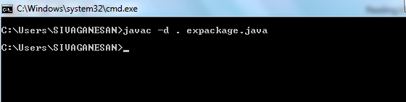
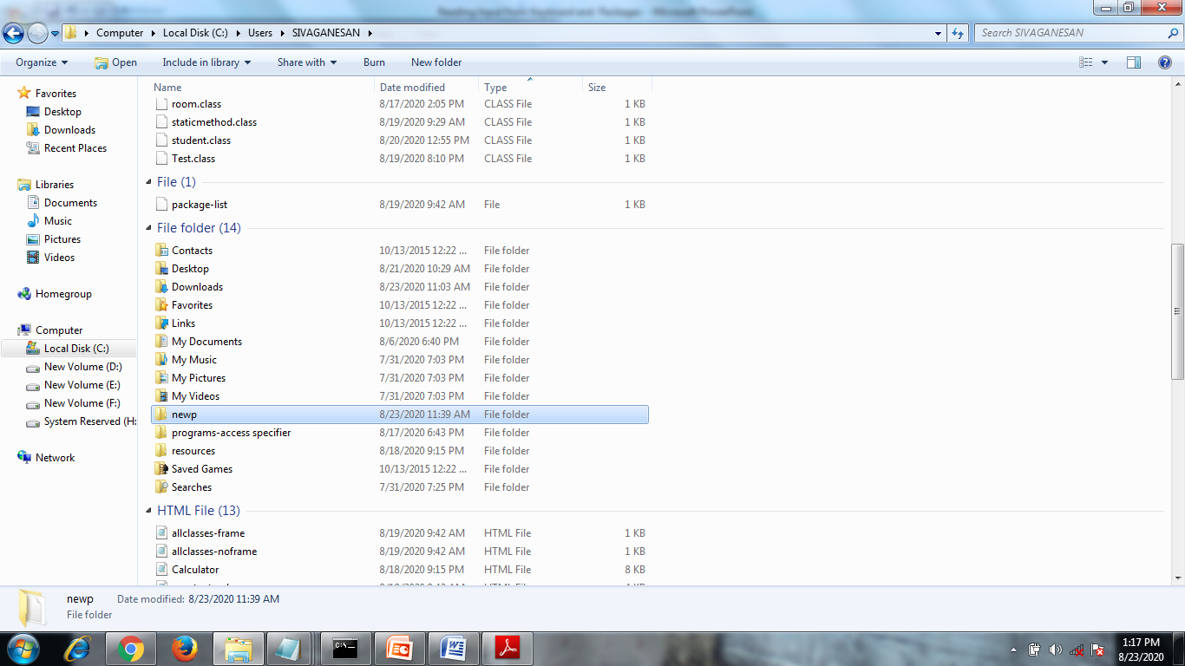

Slide 15


Slide 16
Thank you

